Slide 1
Emilia-Romagna Digital Girls 2023
Foster girls presence in STEM world

Slide 2
Emilia-Romagna Digital Girls 2023
Target audience: girls of 3 ^ and 4 ^ class of high schools;
2023: 300 girls
2023 locations: 10 main municipalities and 6 smaller cities
Mainly female teachers and tutors

Slide 3
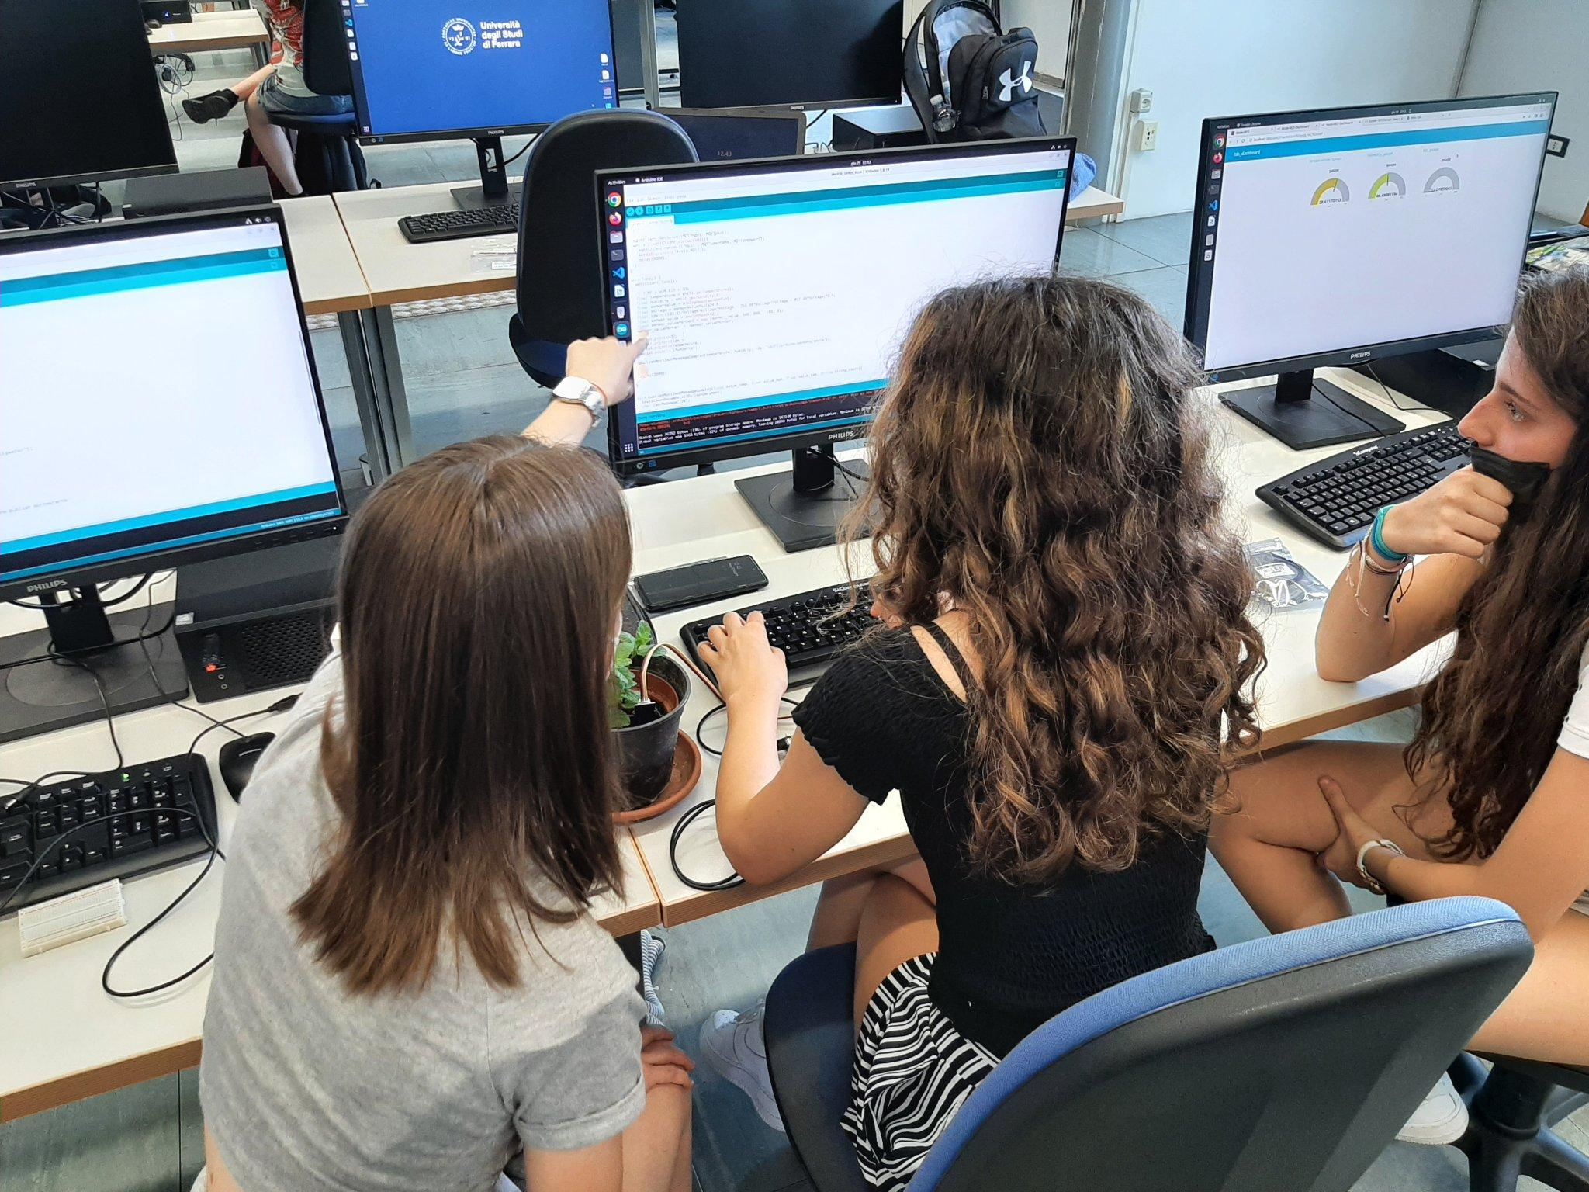
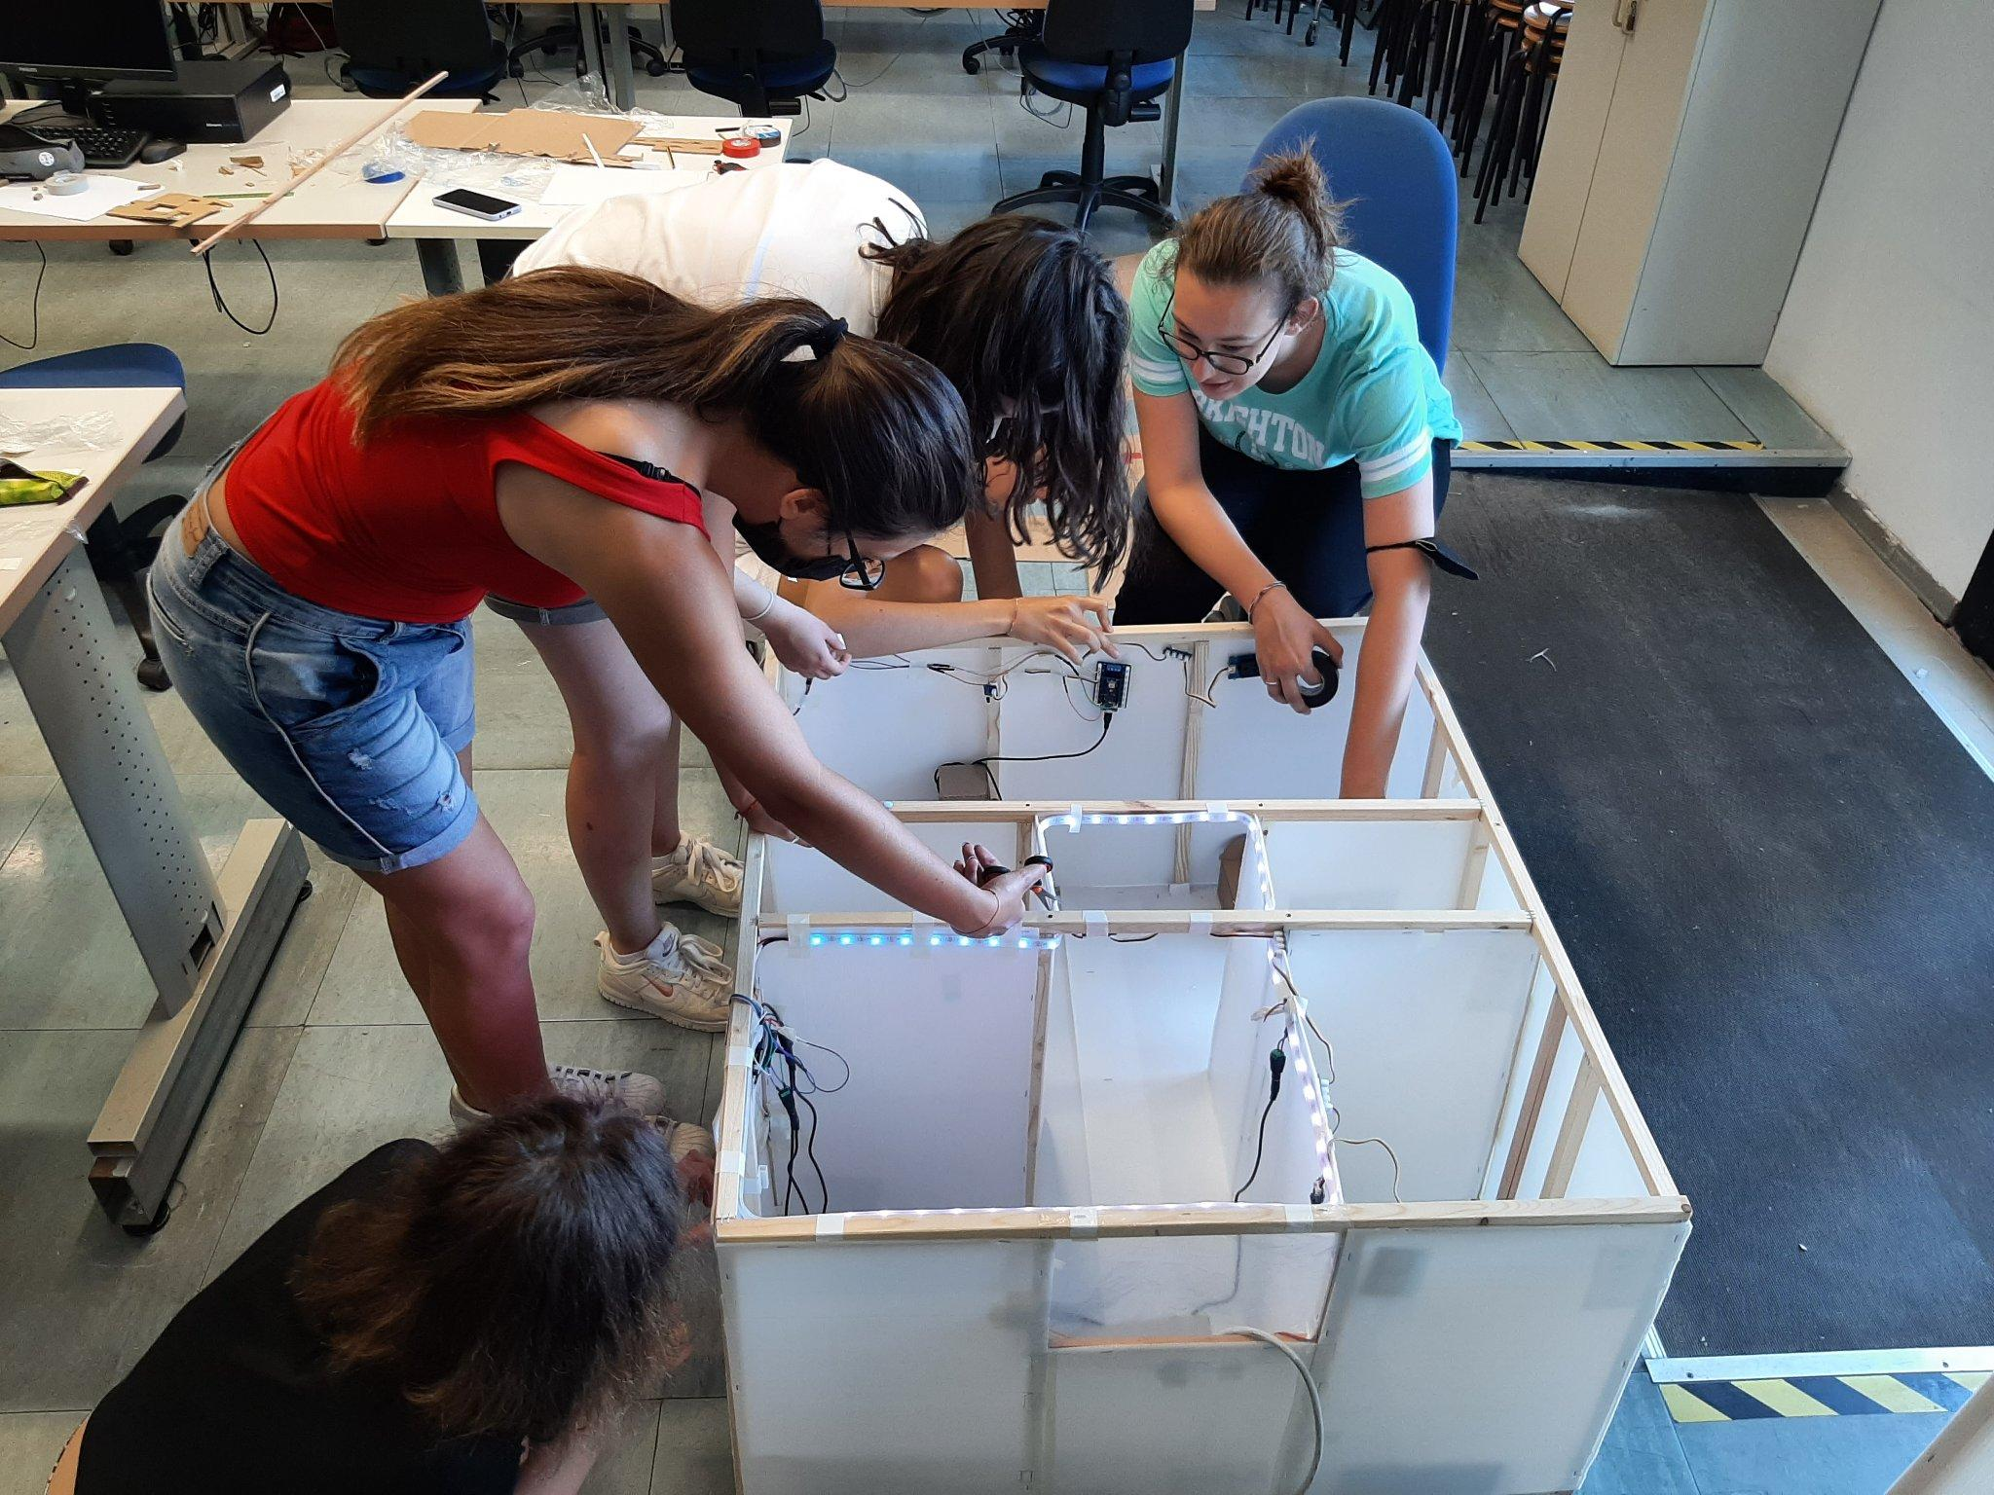
Emilia-Romagna Digital Girls 2023

Slide 4
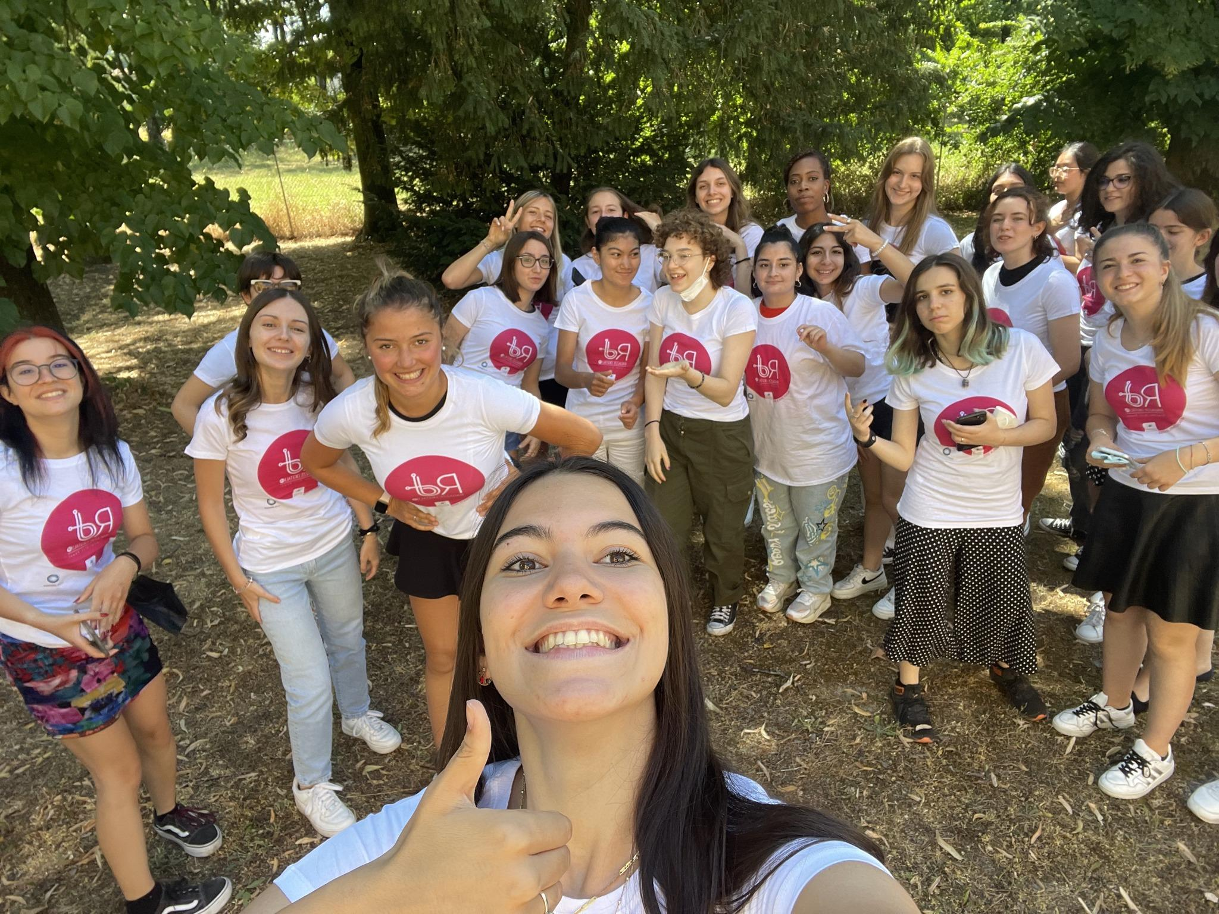
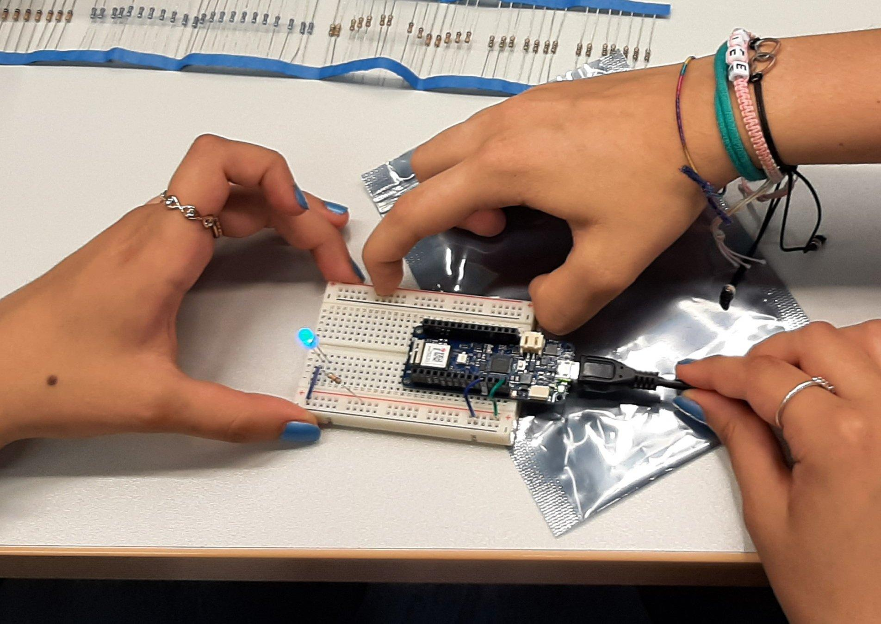
Emilia-Romagna Digital Girls 2023

Slide 5
Emilia-Romagna Digital Girls 2023
Not only computer science, but also
Personal success case stories were presented by female researchers, teachers and professionals in the ICT sector
University guidance activities and promotion of the opportunities offered post-diploma
guided tours to the innovation spaces of Emilia-Romagna

Slide 6
We are proud because….
Good results
A single initiative doesn’t make the change we need to reach
Emilia-Romagna Digital Girls: a Replicable, Sustainable, Scalable «business model» towards a «not only male» digital world
Piece of a bigger puzzle: gender equality as a trasversal priority in public policies: Government programme, Local Guidelines of European Funds,…
Notes:
why did we do that? We need to have more people with these skills, part of a bigger vision to improve society and economy

Slide 7
What’s next?
A new edition in 2024 240,000 euros ESF+ 2021/2027, Priority 1 - Specific objective c
Local Stakeholder involved: Local Unversities, local Training institutions, schools, ESF Managing Authority
26 camps
Action 1 - Summer camp in university and research locations
- Piacenza, Parma, Reggio Emilia, Modena, Bologna, Ferrara, Forlì, Cesena, Ravenna and Rimini;
Action 2 - Widespread Summer camp
In Cities and rural areas not covered by the presence of University
from 40 to 52 classroom hours, including at least a guided tour in the places of excellence of technological innovation in Emilia-Romagna
Notes:
why did we do that? We need to have more people with these skills, part of a bigger vision to improve society and economy

Slide 8
AgendaDigitale@regione.emilia-romagna.it

